Slide 1

C.P. Algebra II
The Conic Sections

Slide 2

The Conic Sections Index
The Conics
Translations
Completing the Square
Classifying Conics

Slide 3
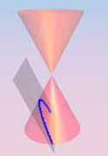
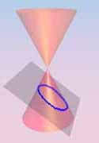
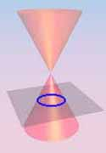
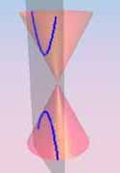
The Conics
Parabola
Ellipse
Click on a Photo
Circle
Hyperbola
Back to Index

Slide 4

The Parabola
A parabola is formed when a plane intersects a cone and the base of that cone

Slide 5
Parabolas
A Parabola is a set of points equidistant from a fixed point and a fixed line.
The fixed point is called the focus.
The fixed line is called the directrix.

Slide 6
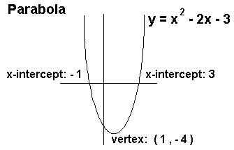

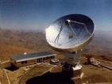
Parabolas Around Us

Slide 7
Parabolas
Parabola
FOCUS
Directrix

Slide 8
Standard form of the equation of a parabola with vertex (0,0)
Equation | Focus | Directrix | Axis
x²=4py | (0,p) | y = -p
y²=4px | (p,0) | y = p

Slide 9
To Find p
4p is equal to the term in front of x or y. Then solve for p.
Example:
x²=24y
4p=24
p=6

Slide 10
Examples for Parabolas
Find the Focus and Directrix
Example 1
y = 4x²
x²= (¹/₄)y
4p = ¹/₄
p = ¹/₁₆
FOCUS
(0, ¹/₁₆)
Directrix
Y = - ¹/₁₆

Slide 11
Examples for Parabolas
Find the Focus and Directrix
Example 2
x = -3y²
y²= (⁻¹/₃)x
4p = ⁻¹/₃
p = ⁻¹/₁₂
FOCUS
(⁻¹/₁₂, 0)
Directrix
x = ¹/₁₂

Slide 12
Examples for Parabolas
Find the Focus and Directrix
Example 3 (try this one on your own)
y = -6x²
FOCUS
????
Directrix
????

Slide 13
Examples for Parabolas
Find the Focus and Directrix
FOCUS
(0, -¹/₂₄)
Example 3
y = -6x²
Directrix
y = ¹/₂₄

Slide 14
Examples for Parabolas
Find the Focus and Directrix
Example 4 (try this one on your own)
x = 8y²
FOCUS
????
Directrix
????

Slide 15
Examples for Parabolas
Find the Focus and Directrix
FOCUS
(2, 0)
Example 4
x = 8y²
Directrix
x = -2

Slide 16
Parabola Examples
Now write an equation in standard form for each of the following four parabolas

Slide 17
Write in Standard Form
Example 1
Focus at (-4,0)
Identify equation
y² =4px p = -4
y² = 4(-4)x
y² = -16x

Slide 18
Write in Standard Form
Example 2
With directrix y = 6
Identify equation
x² =4py p = -6
x² = 4(-6)y
x² = -24y

Slide 19
Write in Standard Form
Example 3 (Now try this one
on your own)
With directrix x = -1
y² = 4x

Slide 20
Write in Standard Form
Example 4 (On your own)
Focus at (0,3)
x² = 12y
Back to Conics

Slide 21

Circles
A Circle is formed when a plane intersects a cone parallel to the base of the cone.

Slide 22
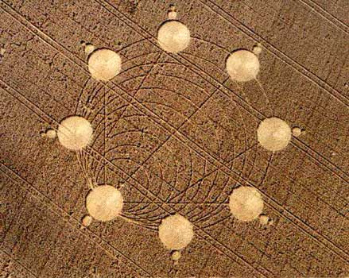
Circles

Slide 23
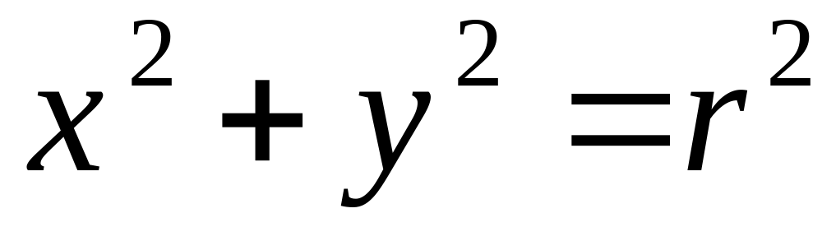
Standard Equation of a Circle with Center (0,0)

Slide 24
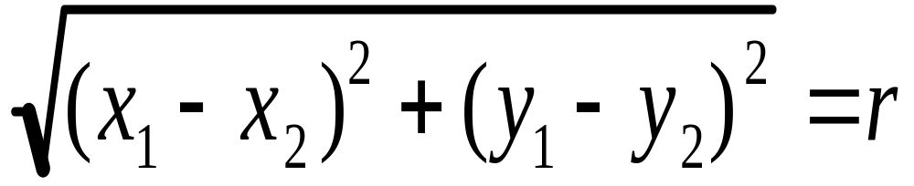
Circles & Points of Intersection
Distance formula used to find the radius

Slide 25
Circles
Example 1
Write the equation of the circle with the point (4,5) on the circle and the origin as it’s center.

Slide 26

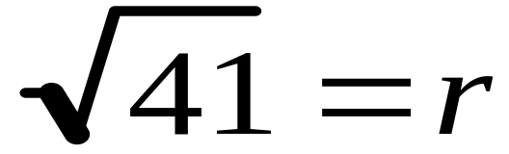
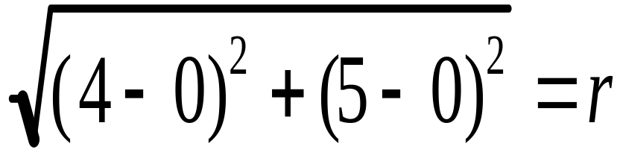
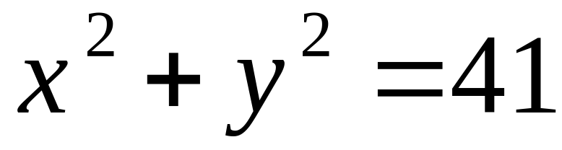
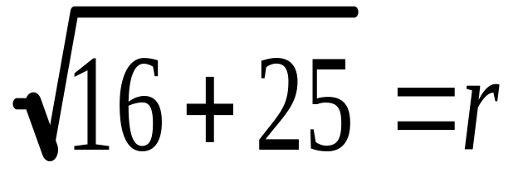
Example 1
Point (4,5) on the circle and the origin as it’s center.

Slide 27
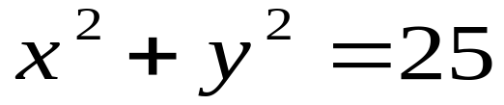
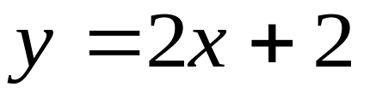
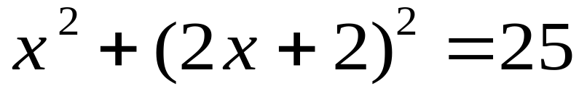
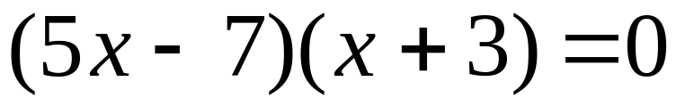
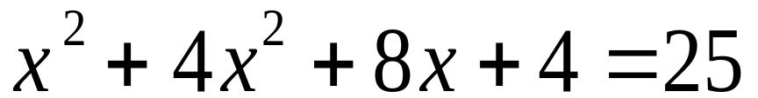
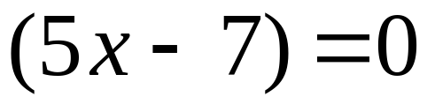
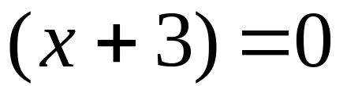
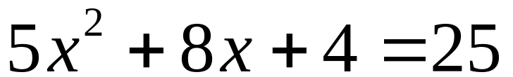
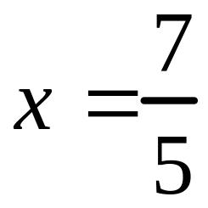

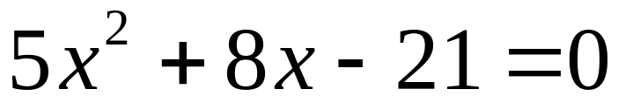
Example 2
Find the intersection points on the graph of the following two equations

Slide 28


Now what??!!??!!??

Slide 29
Example 2
Find the intersection points on the graph of the following two equations
Plug these in for x.

Slide 30
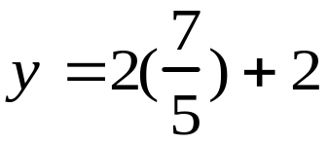

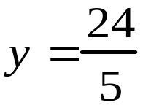
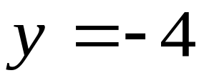
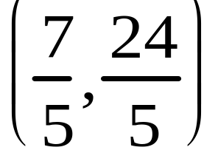
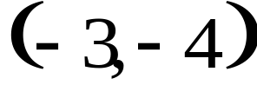
Example 2
Find the intersection points on the graph of the following two equations
Back to Conics

Slide 31

Ellipses

Slide 32
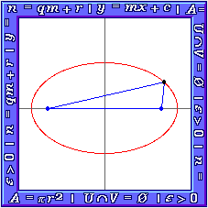



Ellipses
Examples of Ellipses

Slide 33
Ellipses
Horizontal Major Axis

Slide 34
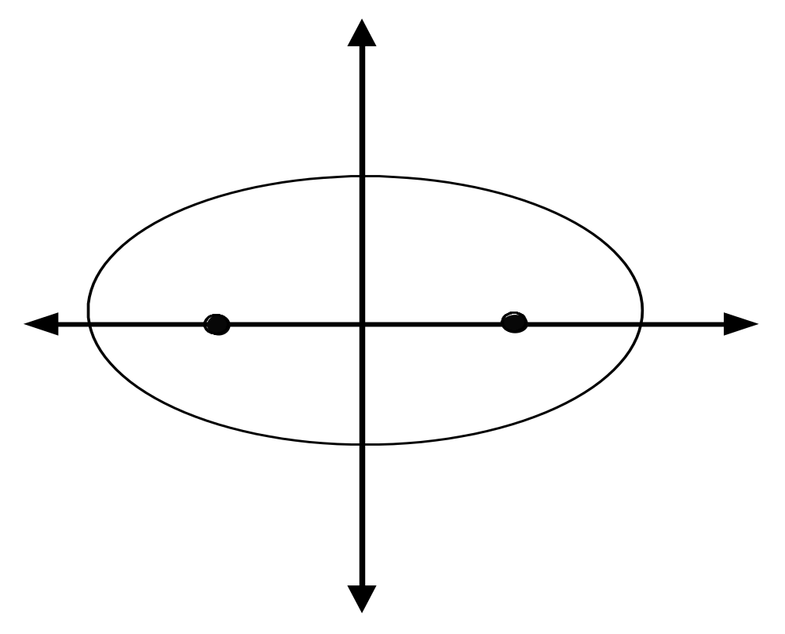
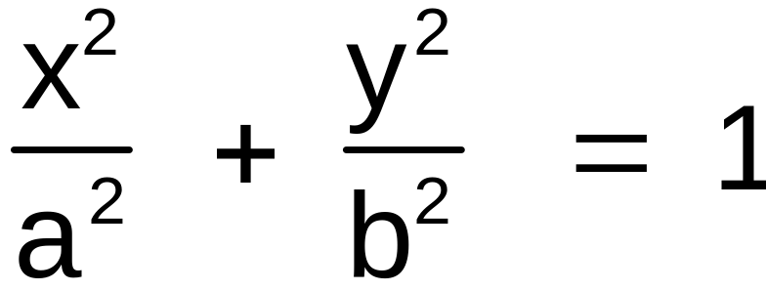


FOCI
(-c,0) & (c,0)
CO-VERTICES
(0,b)& (0,-b)
The
Equation
CENTER (0,0)
Vertices
(-a,0) & (a,0)

Slide 35
Ellipses
Vertical Major Axis

Slide 36
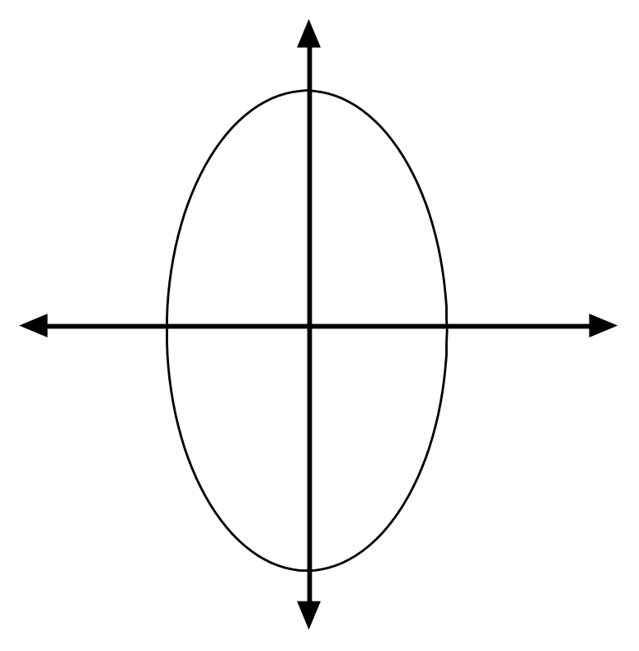
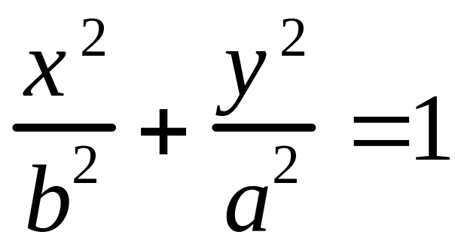
FOCI
(0,-c) & (0,c)
CO-VERTICES
(b, 0)& (-b,0)
The
Equation
CENTER (0,0)
Vertices
(0,-a) & (0, a)

Slide 37
Ellipse Notes
Length of major axis = a (vertex & larger #)
Length of minor axis = b (co-vertex & smaller#)
To Find the foci (c) use:
  c² = a² ⁻ b²

Slide 38
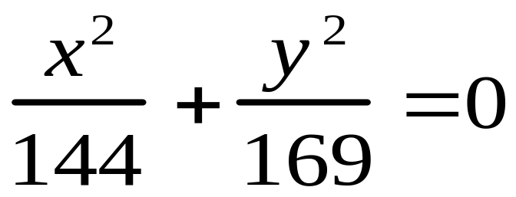
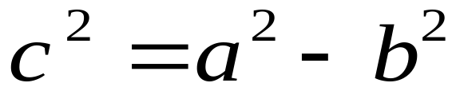

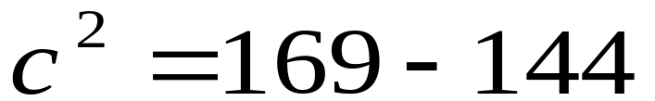
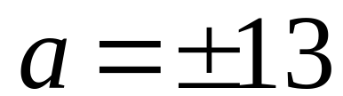
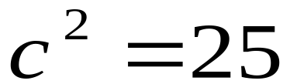

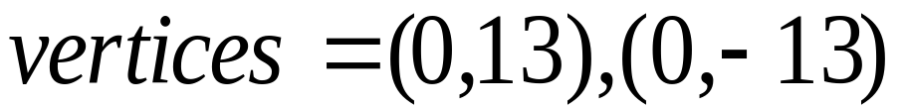

Ellipse Examples
Find the Foci and Vertices

Slide 39
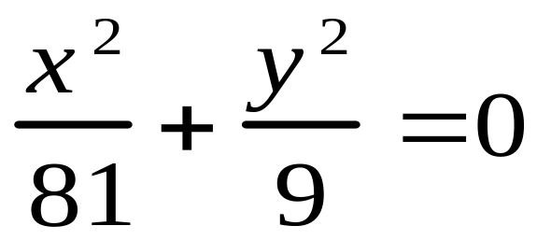
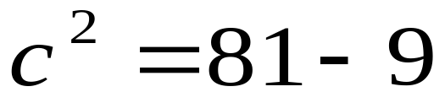
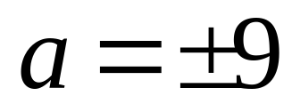
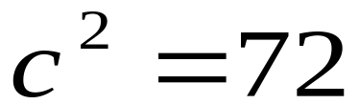
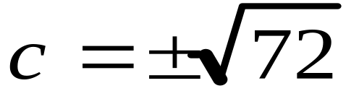
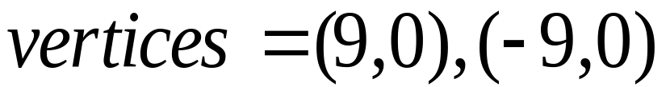
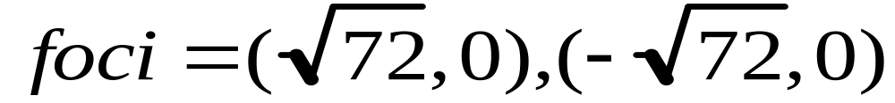
Ellipse Examples
Find the Foci and Vertices

Slide 40


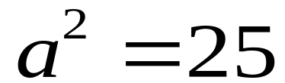
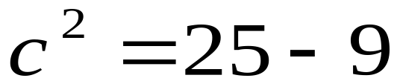

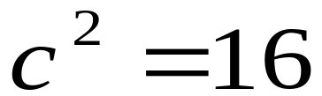

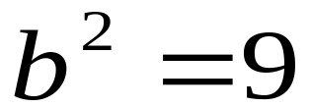


Write an equation of an ellipse whose vertices are (-5,0) & (5,0) and whose co-vertices are (0,-3) & (0,3). Then find the foci.

Slide 41








Write the equation in standard form and then find the foci and vertices.

Slide 42

Back to the Conics

Slide 43
The Hyperbola

Slide 44




Hyperbola Examples

Slide 45
Hyperbola Notes
Horizontal Transverse Axis
Center (0,0)
Asymptotes
Vertices (a,0) &
(-a,0)
Foci (c,0) &
(-c, 0)

Slide 46


Hyperbola Notes
Horizontal Transverse Axis
Equation

Slide 47


Hyperbola Notes
Horizontal Transverse Axis
To find asymptotes

Slide 48
Hyperbola Notes
Vertical Transverse Axis
Center (0,0)
Vertices (a,0) &
(-a,0)
Asymptotes
Foci (c,0) &
(-c, 0)

Slide 49

Hyperbola Notes
Vertical Transverse Axis
Equation

Slide 50


Hyperbola Notes
Vertical Transverse Axis
To find asymptotes

Slide 51





Write an equation of the hyperbola with foci (-5,0) & (5,0) and vertices (-3,0) & (3,0)
a = 3 c = 5

Slide 52




Write an equation of the hyperbola with foci (0,-6) & (0,6) and vertices (0,-4) & (0,4)
a = 4 c = 6
The Conics

Slide 53
Translations
What happens when the conic is NOT centered on (0,0)?
Back
Next

Slide 54


Translations
Circle
Next

Slide 55


Translations
Parabola
Horizontal Axis
or
Vertical Axis
Next

Slide 56


Translations
Ellipse
or
Next

Slide 57


Translations
Hyperbola
or
Next

Slide 58

Translations
Identify the conic and graph
r=
3
center
(1,-2)
Next

Slide 59

Translations
Identify the conic and graph
Next

Slide 60

Translations
Identify the conic and graph
center
vertices
asymptotes
Next

Slide 61

Translations
Identify the conic and graph
Conic
center
Back to Index

Slide 62
Completing the Square
Here are the steps for completing the square
Steps
  Group x² + x, y²+y move constant
  Take # in front of x, ÷2, square, add to both sides
  Repeat Step 2 for y if needed
  Rewrite as perfect square binomial
Next

Slide 63
Completing the Square
Circle: x²+y²+10x-6y+18=0
x²+10x+____ + y²-6y=-18
(x²+10x+25) + (y²-6y+9)=-18+25+9
(x+5)² + (y-3)²=16
Center (-5,3) Radius = 4
Next

Slide 64

Completing the Square
Ellipse: x²+4y²+6x-8y+9=0
x²+6x+____ + 4y²-8y+____=-9
(x²+6x+9) + 4(y²-2y+1)=-9+9+4
(x+3)² + (y-1)²=4
Index
C: (-3,1)
a=2, b=1

Slide 65

Classifying Conics

Slide 66



Classifying Conics
Given in General Form
Next

Slide 67
Classifying Conics
Given in General Form
Examples

Slide 68







Classifying Conics
Given in general form, classify the conic
Ellipse
Next

Slide 69





Classifying Conics
Given in general form, classify the conic
Parabola
Next

Slide 70






Classifying Conics
Given in general form, classify the conic
Hyperbola
Next

Slide 71





Classifying Conics
Given in general form, classify the conic
Hyperbola
Back to Index

Slide 72
Classifying Conics
Given in General Form
Then
If A = C
OR
Back
Ellipse
Circle

Slide 73

Classifying Conics
Given in General Form
Then
Parabola
Back

Slide 74
Classifying Conics
Given in General Form
Then
Hyperbola
Back

